Slide 1
William Roberts Prof. Stephen Leggett Task7- LOR-DC1

Slide 2
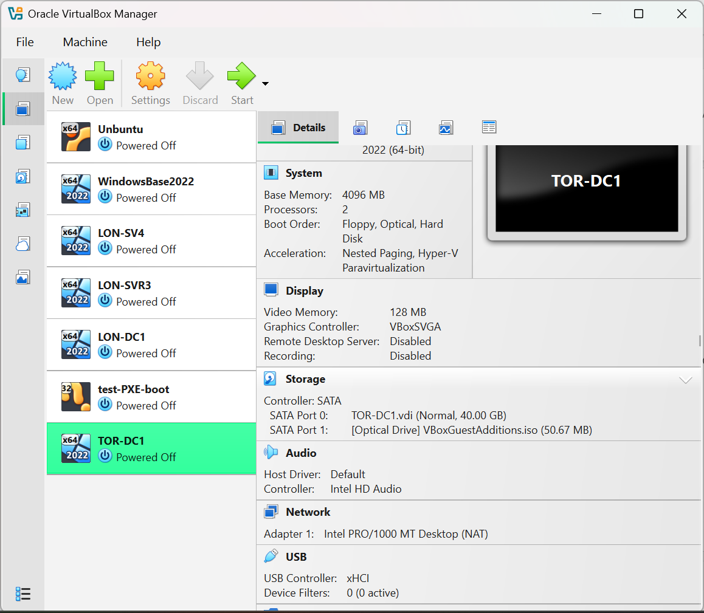
Clone Base to TOR-DC1

Slide 3
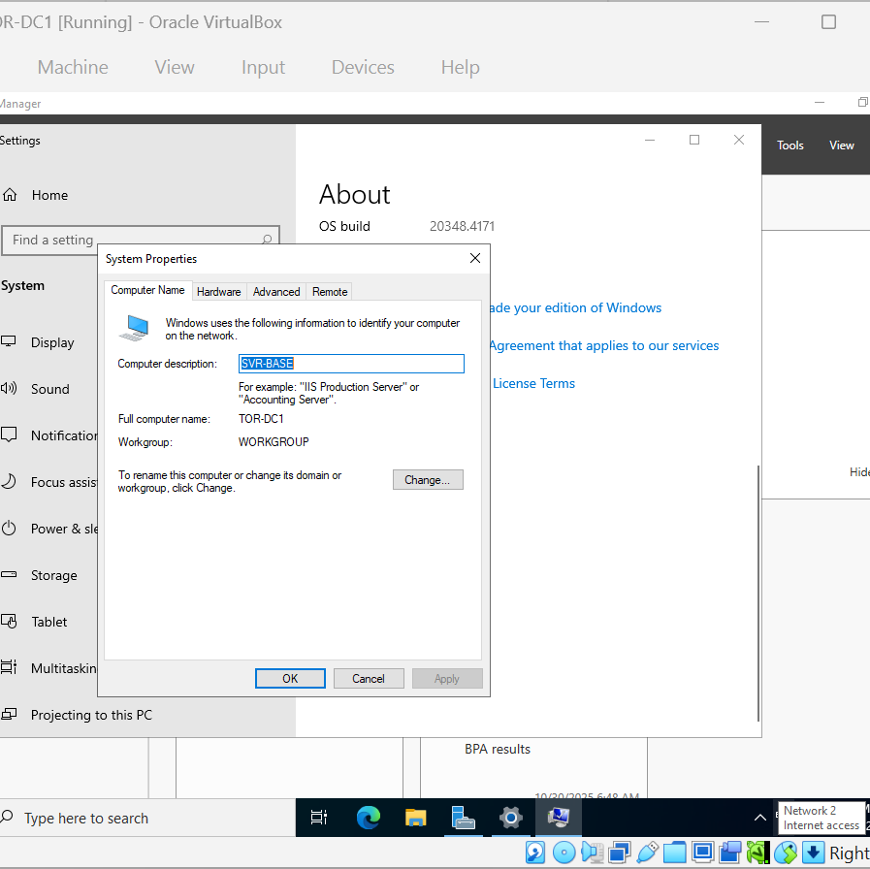
Setting up TOR-DC1
Instructions are for older version of the VM. Had to scroll down to advanced system setting to access this.

Slide 4
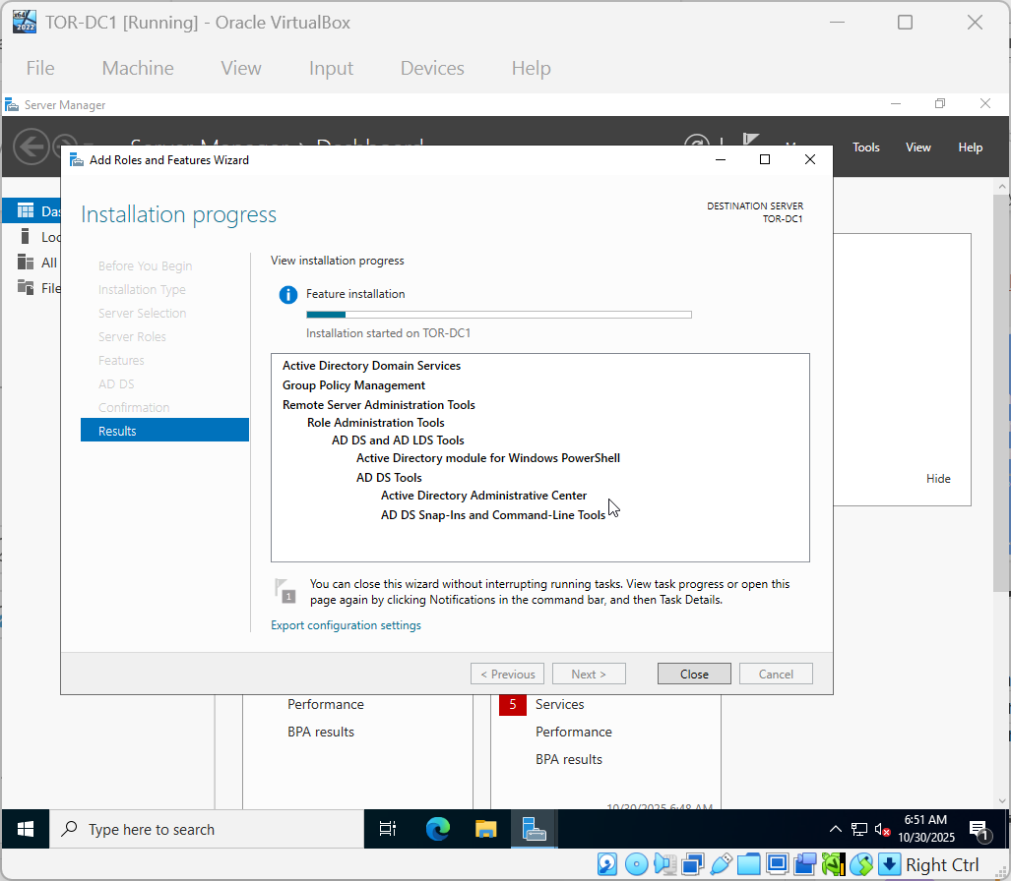
Adding Active Directory Domain Services

Slide 5
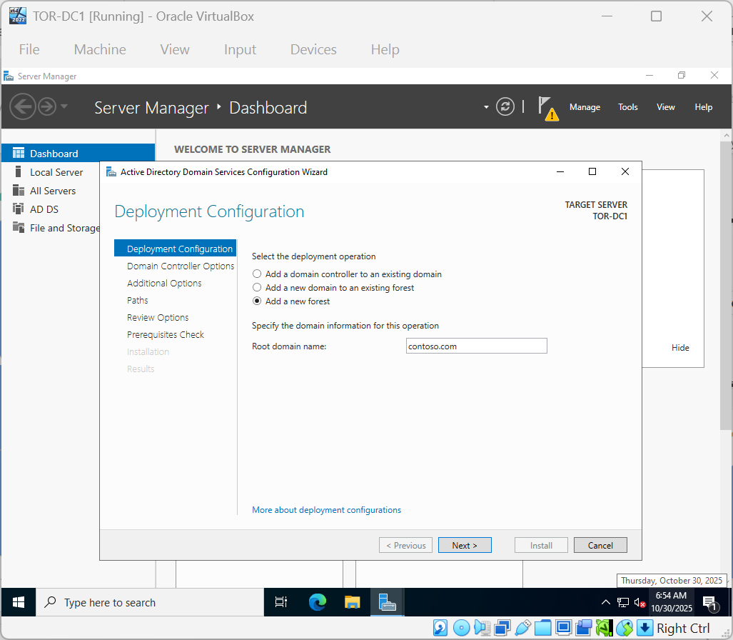
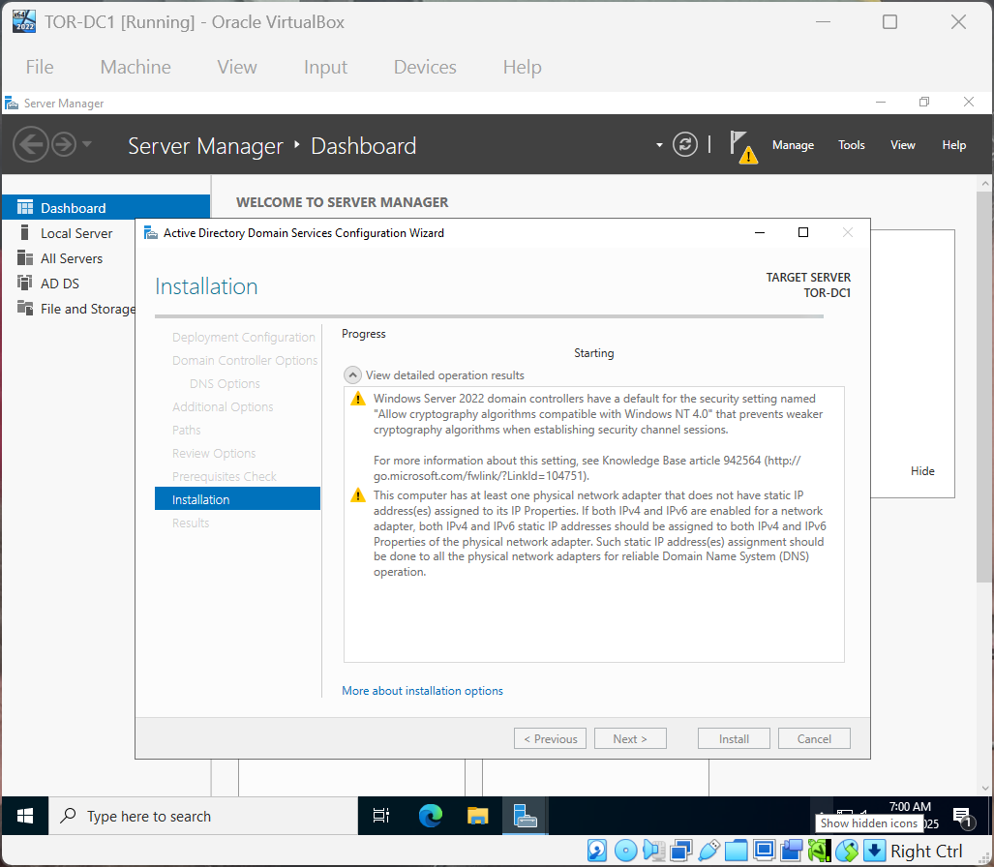
Add New Forest

Slide 6
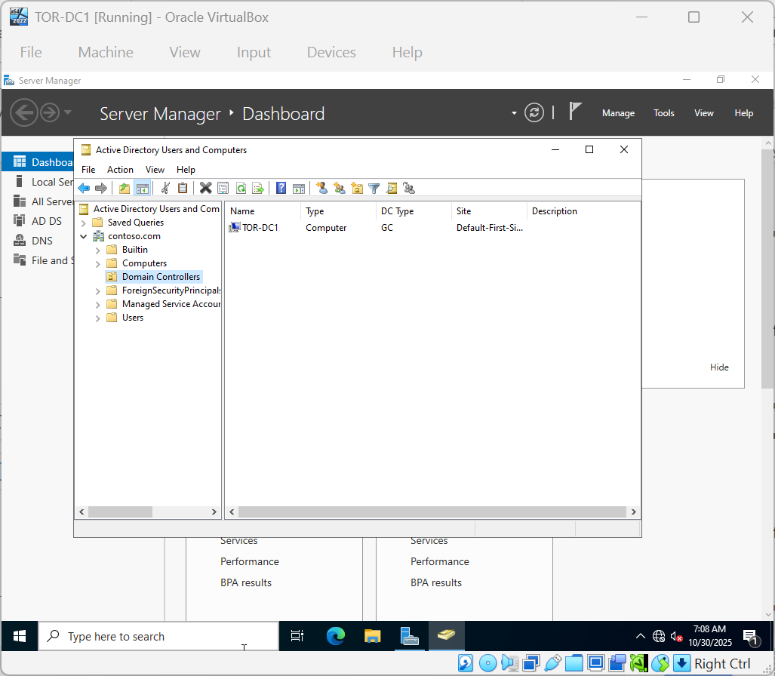
Open Domain Controllers

Slide 7
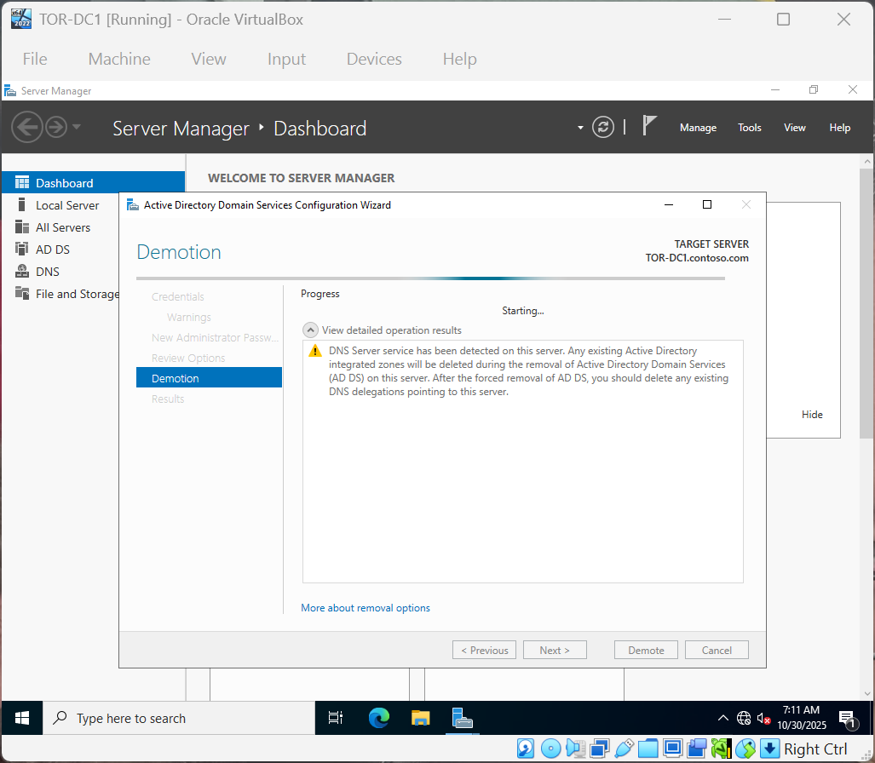
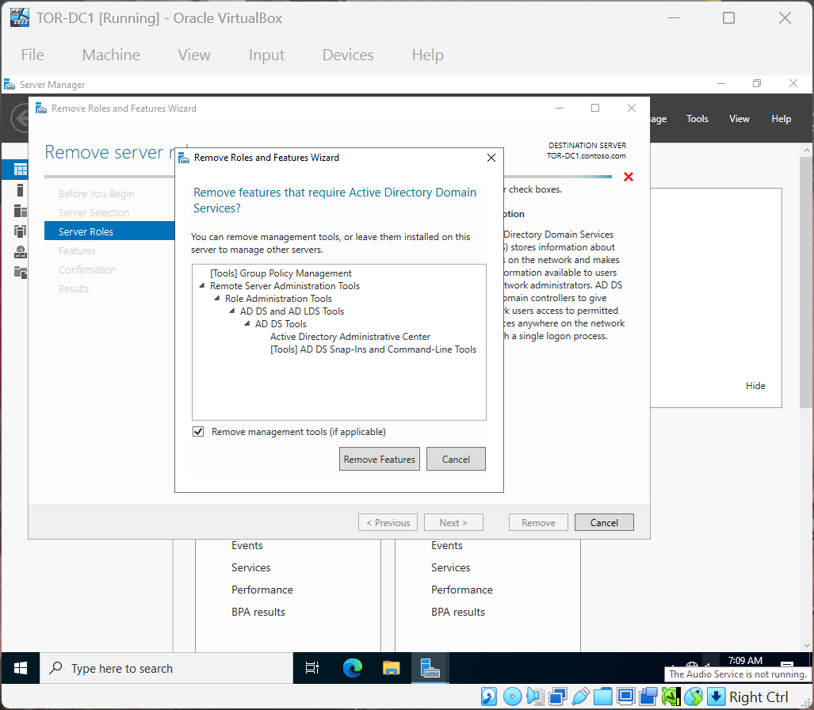
Remove ADDS and Demote TOR-DC1

Slide 8
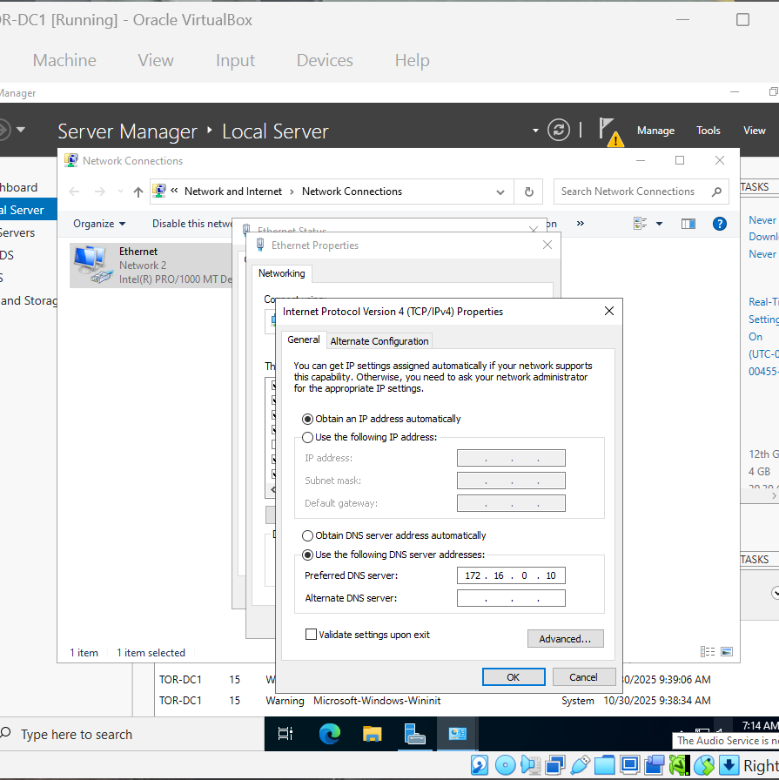
Set Preferred DNS address

Slide 9
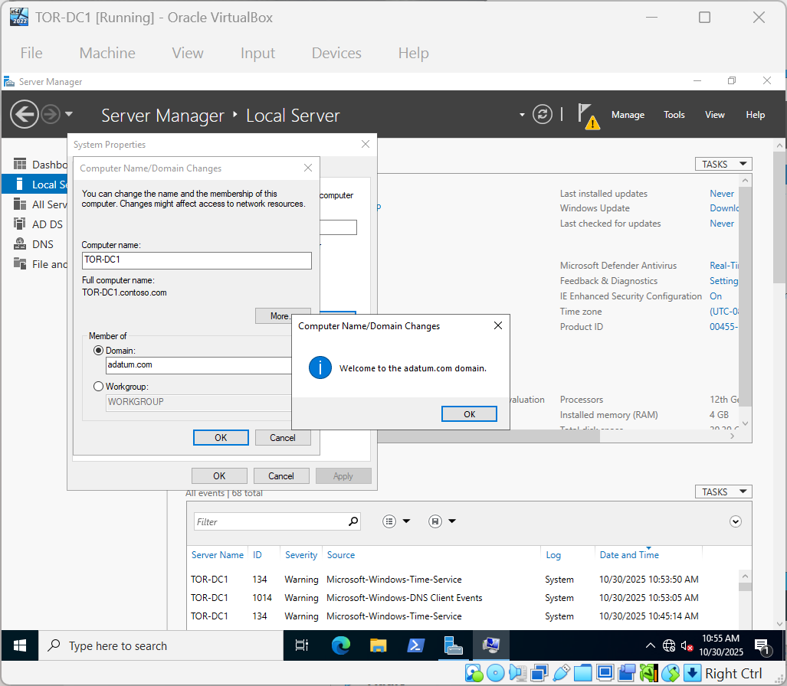
Change Domain

Slide 10
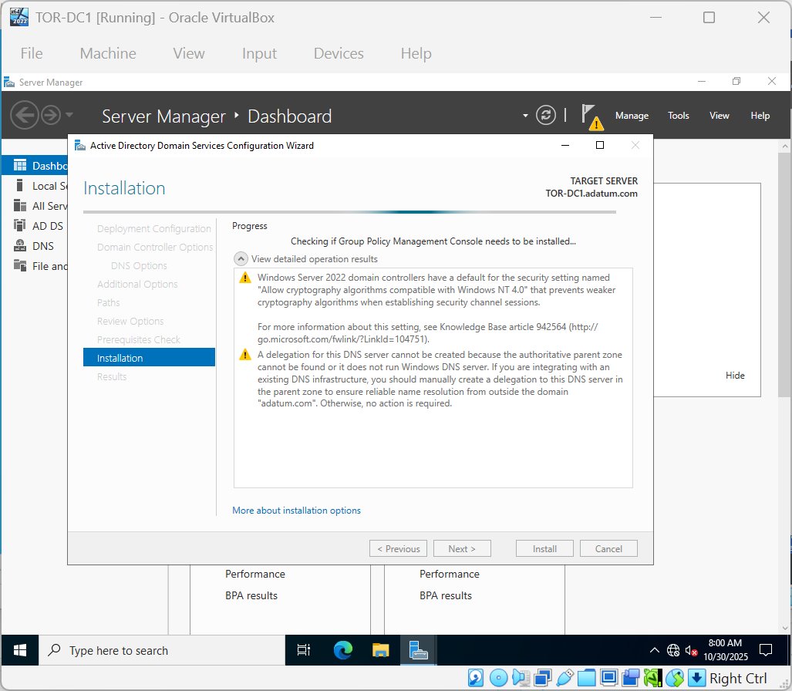
Promoting TOR-DC1 to controller on existing Domain

Slide 11
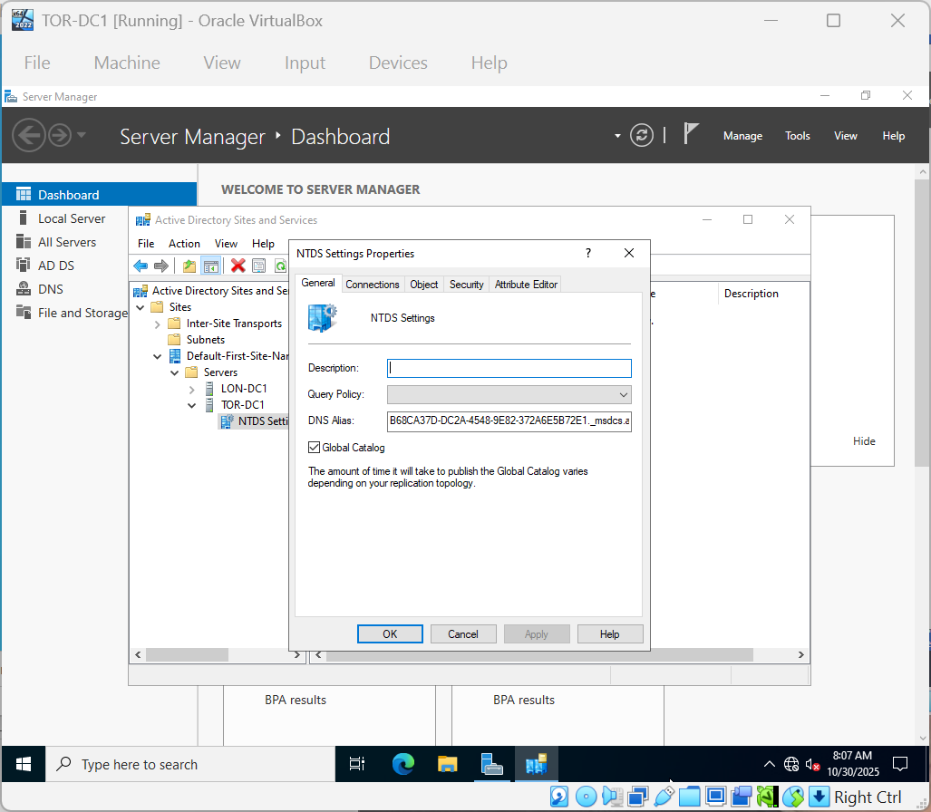
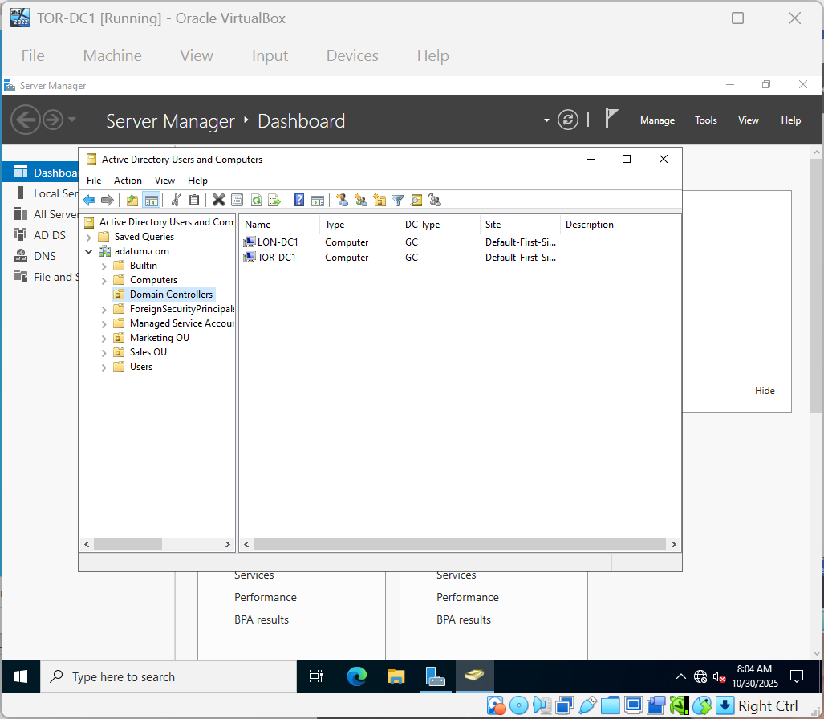
Domain Controllers & NTDS Settings

Slide 12
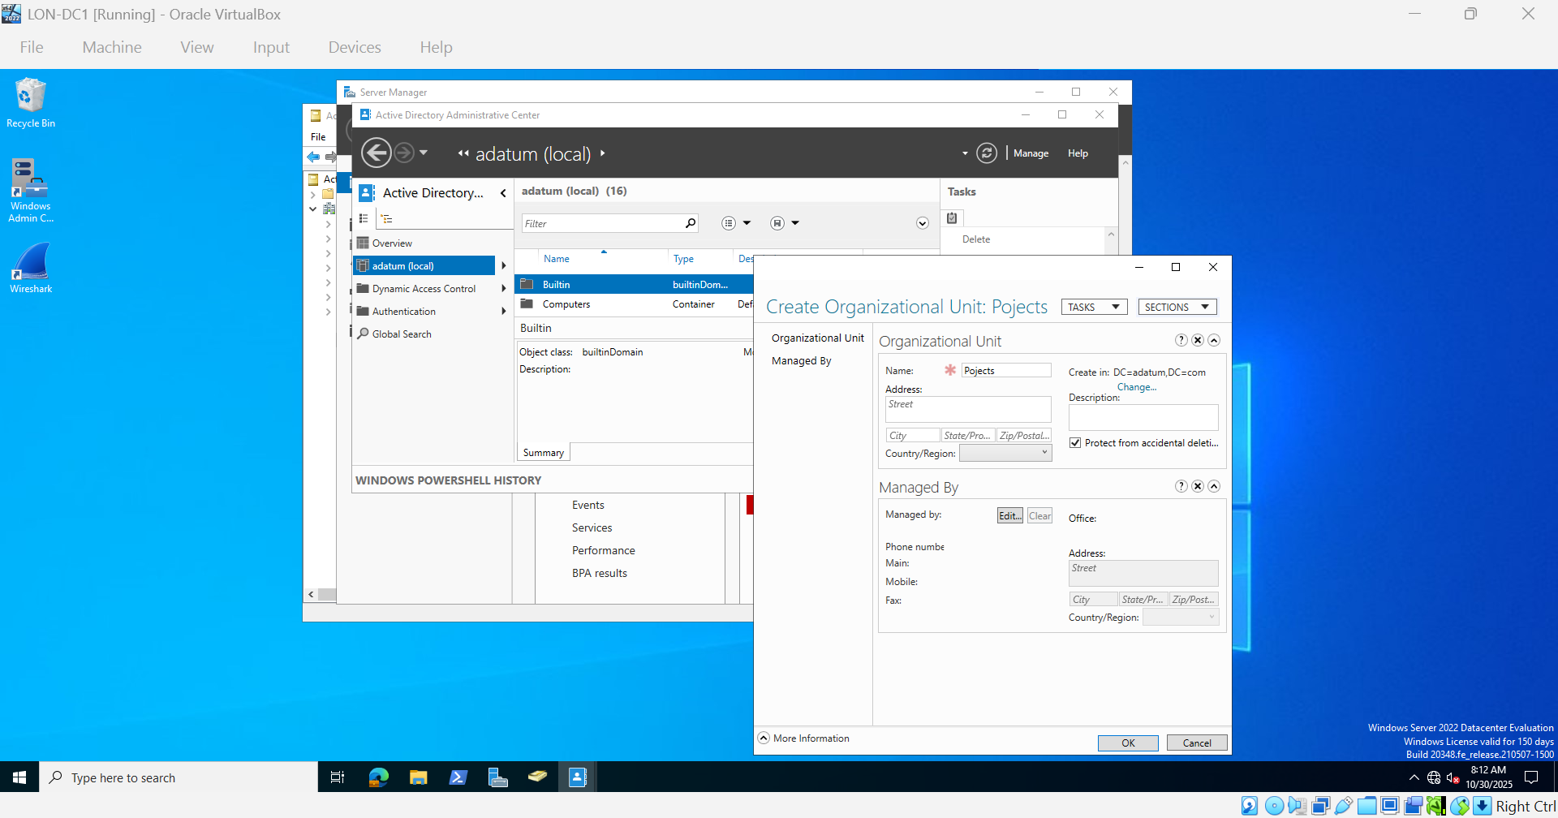
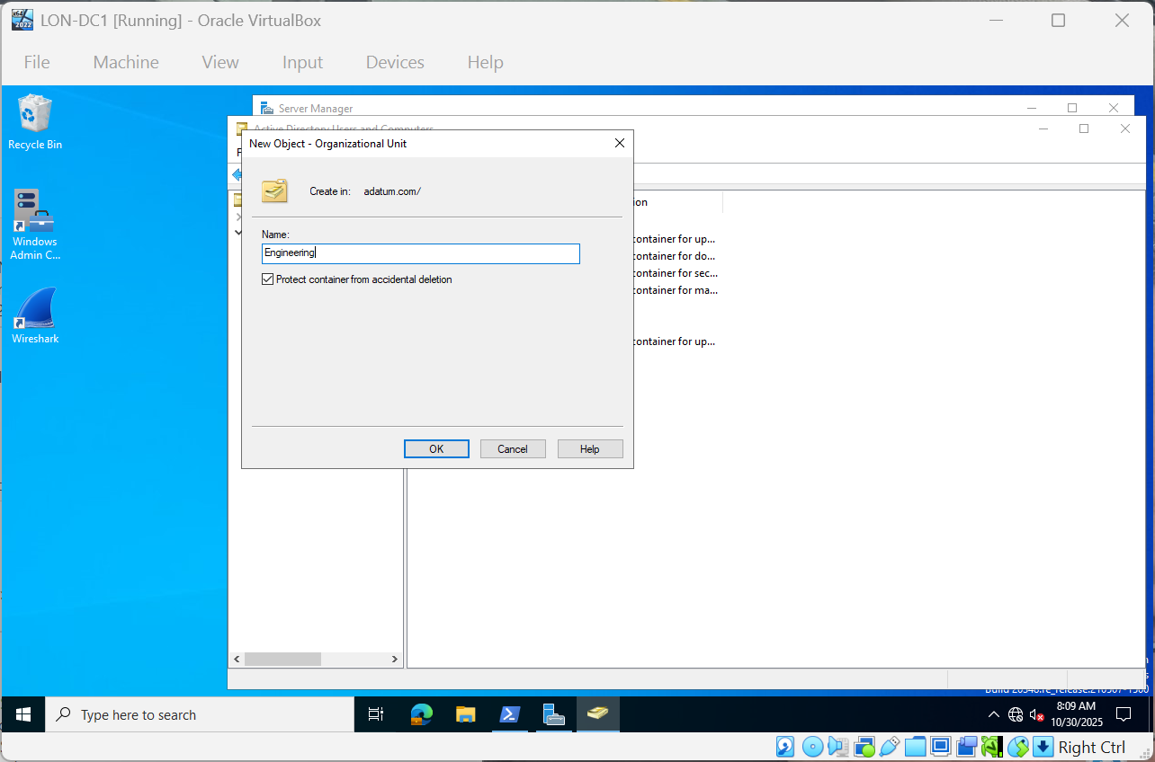
Create OU – Engineering & Projects LON-DC1

Slide 13
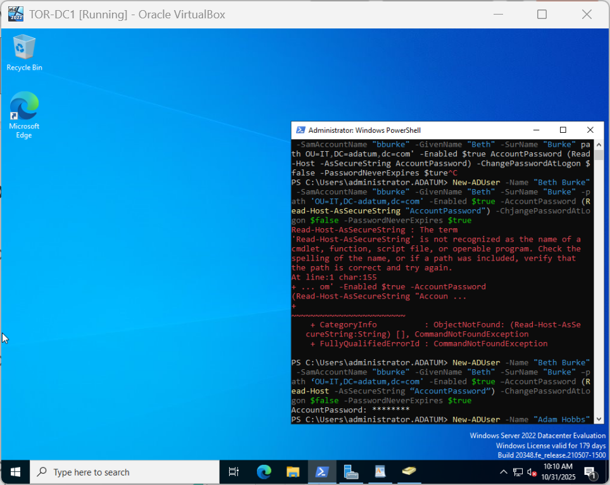
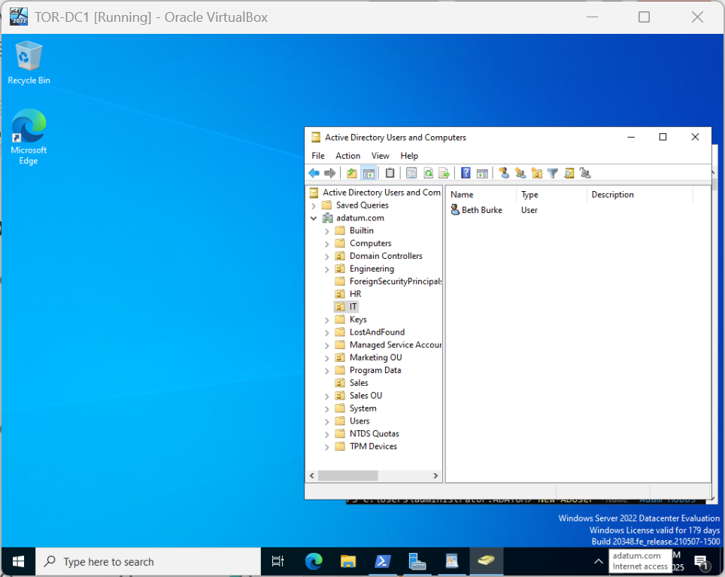
Add OU and Users using the command-lets

Slide 14
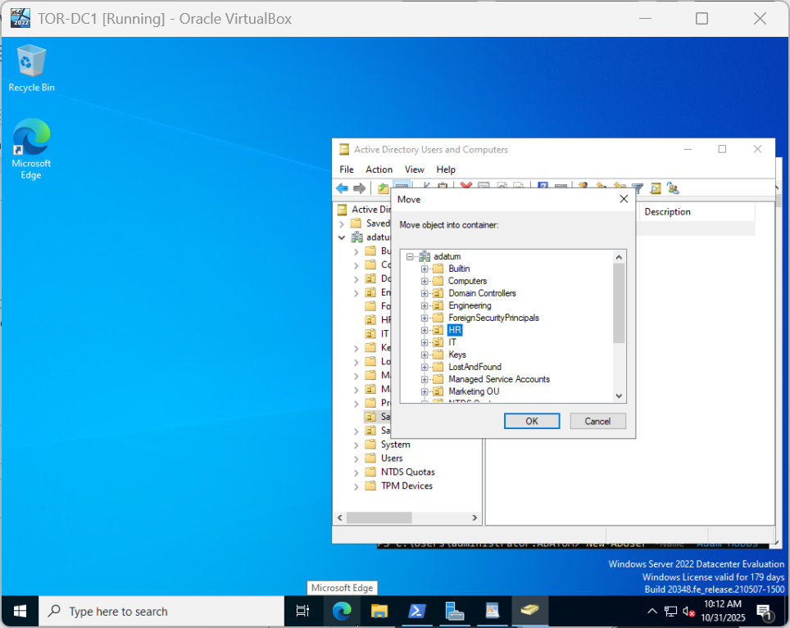
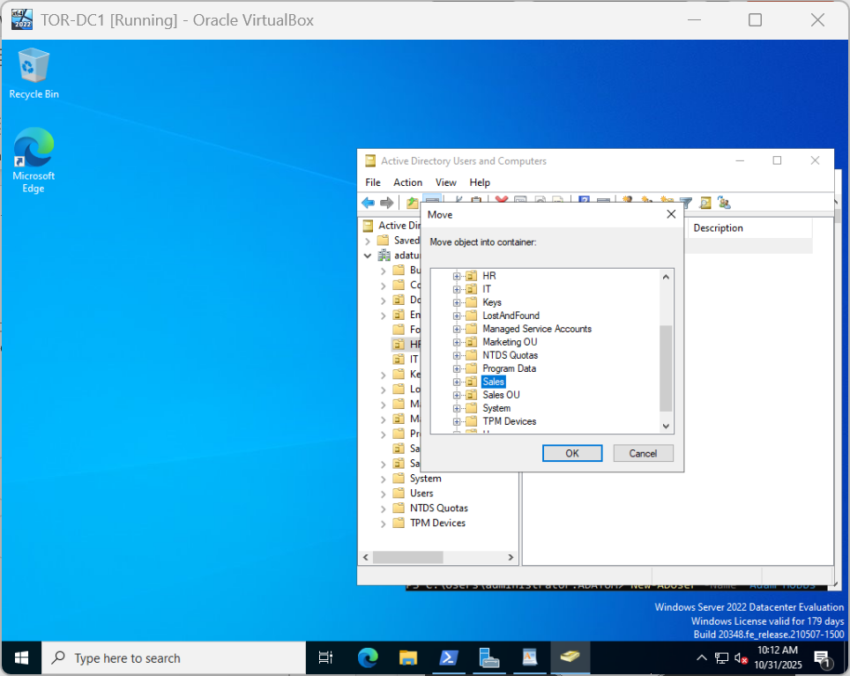
Move user to HR and Back to Sales

Slide 15
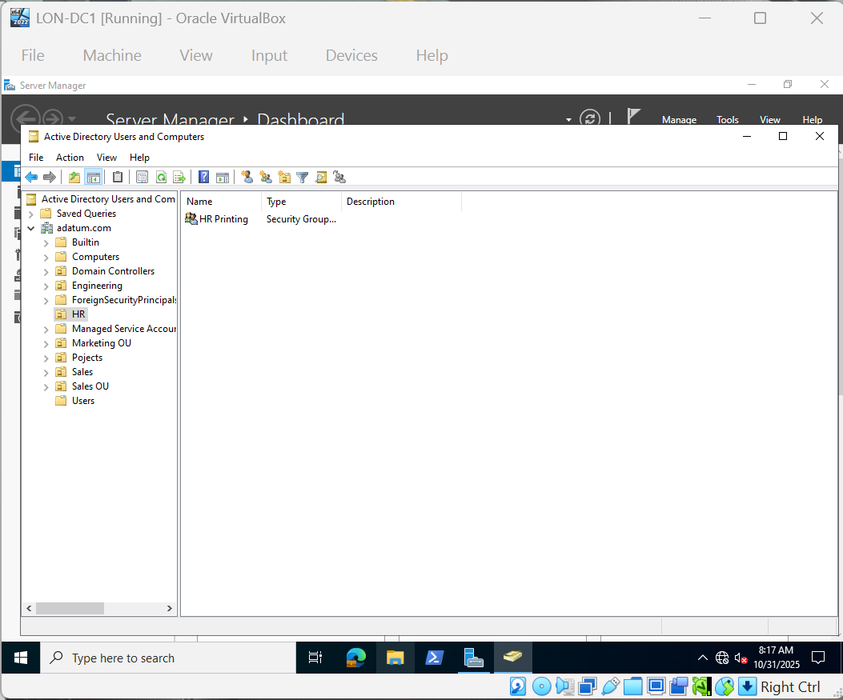
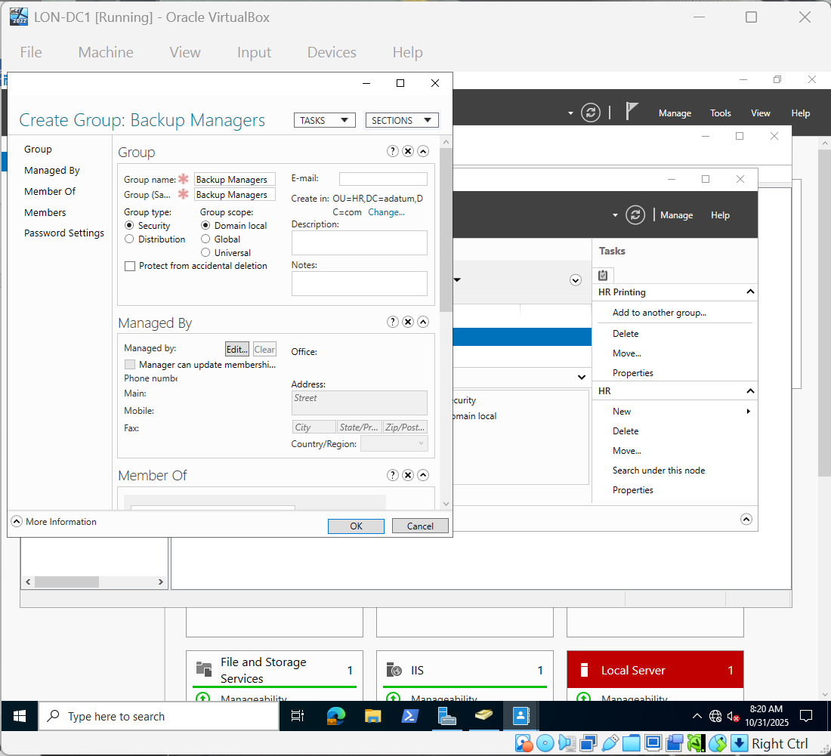
Add HR Printing & Backup Managers on LON-DC1

Slide 16
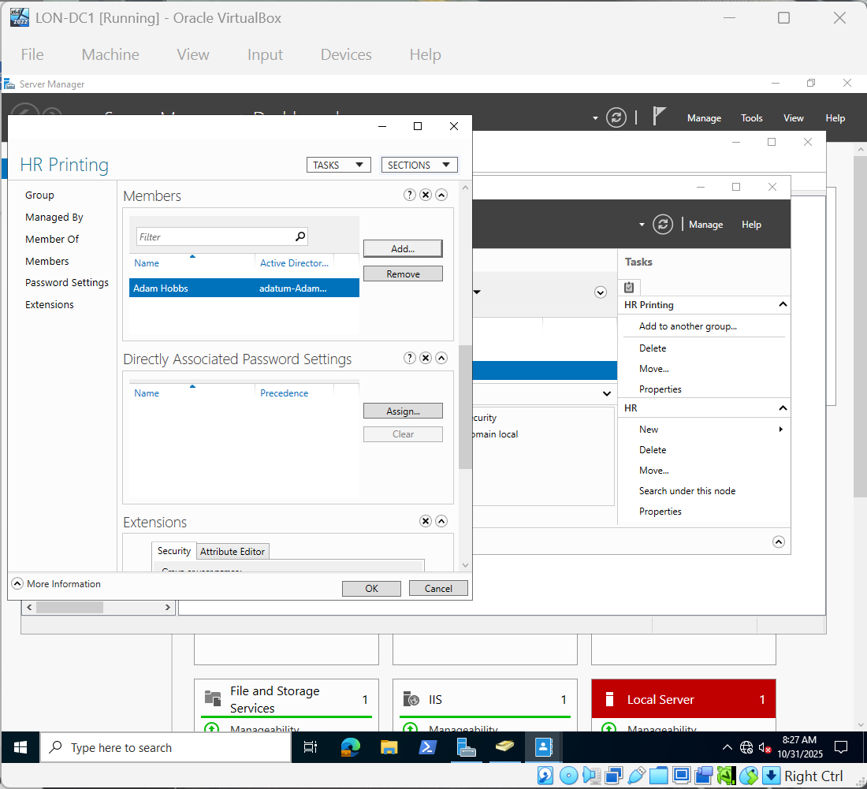
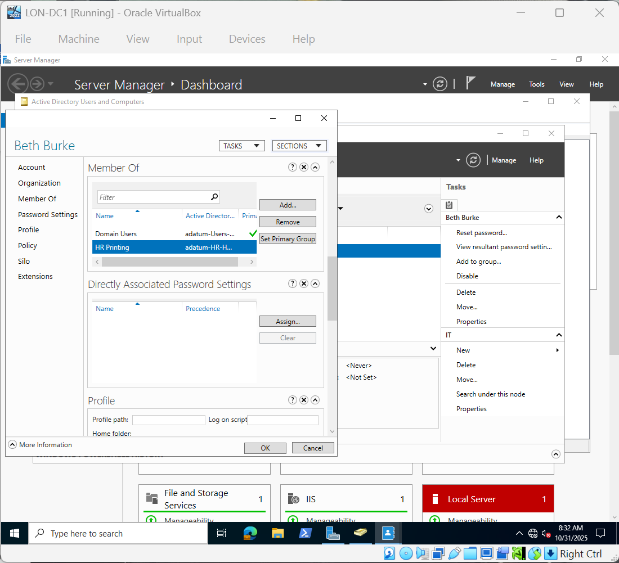
Add users to HR Printing

Slide 17
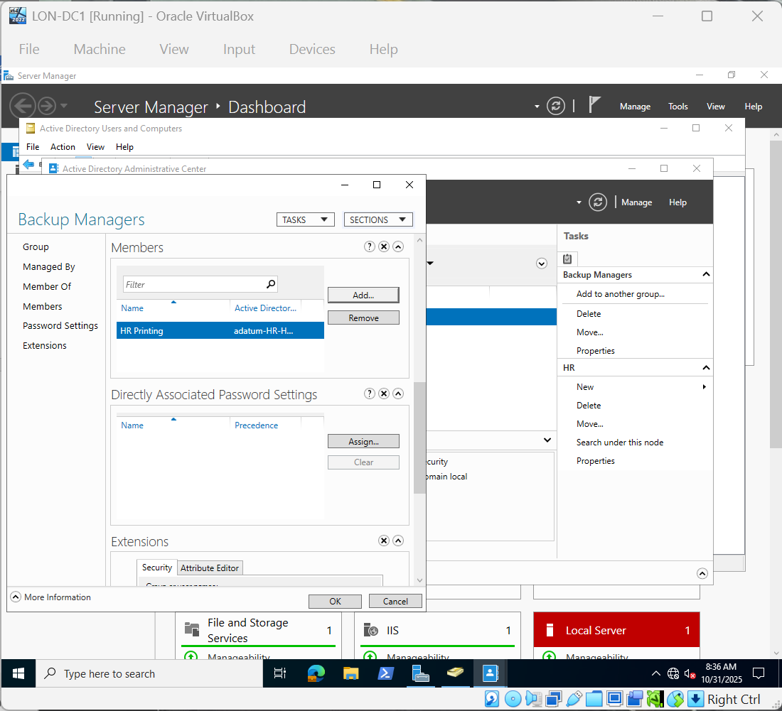
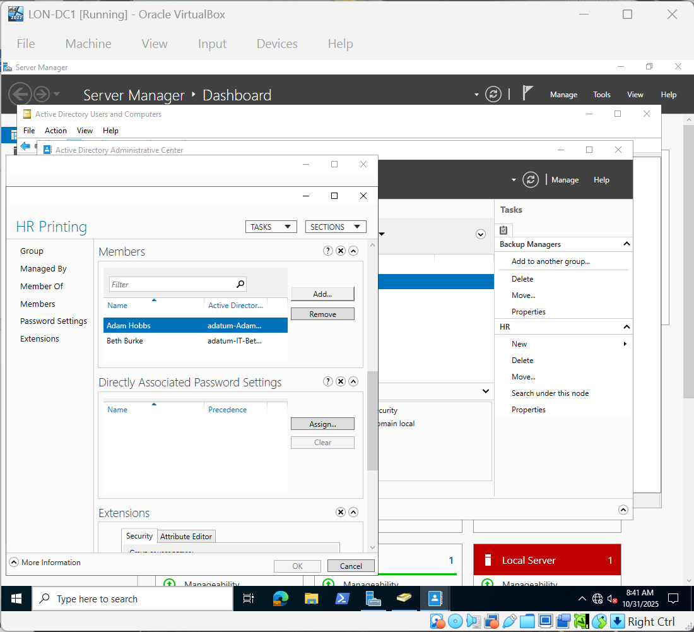
Add members to Backup Managers

